Slide 1


M.Tech Program
Advanced Industry Integrated Programs
Jointly offered by VIT University(Chennai) and LTM
Review I
Project 1: Claim Sense: RAG-Based Insurance Claims Adjudication & Policy Knowledge Assistant
Project 2: Site Guard: AI Multi-Agent Construction Safety & Quality Incident Resolution System
S K Sricharan
T-SERIES: T9984
Knowledge partner | Implementation partner

Slide 2
Project 1 | Claim Sense: RAG Claims Adjudication
Introduction
P&C and health insurers take 5–10 days per claim because adjusters manually cross-check policy wordings, exclusion clauses and regulatory circulars — Claim Sense automates this using Retrieval-Augmented Generation (RAG).
The system ingests a claim (structured data + free-text incident description), retrieves the exact clause(s) from the customer's policy and applicable IRDAI regulations, scores fraud/anomaly risk with a trained ML model, and generates a citation-backed Approve / Investigate / Deny recommendation.
Outcome: adjudication turnaround drops from days to minutes, decisions become consistent across adjusters, and claim leakage from missed exclusions is reduced.
As a product, Claim Sense ships as an adjuster-facing dashboard (Streamlit + FastAPI) deployed on Azure (AKS), with MLflow-tracked models and CI/CD — usable as an internal claims copilot or licensed as a SaaS adjudication layer.

Slide 3
Project 1 | Claim Sense: RAG Claims Adjudication
Objective
Ingest structured claim data and free-text incident narratives for automated triage
Build a hybrid (dense + keyword) RAG knowledge base over policy wordings, exclusion clauses and IRDAI regulatory circulars
Classify fraud/anomaly risk (Low / Medium / High) using engineered claim features and gradient-boosted models
Retrieve and cite the exact policy clause(s) that justify a decision, eliminating unsupported recommendations
Generate an explainable Approve / Investigate / Deny recommendation with inline reasoning
Provide an interactive adjuster dashboard with claim-trend and clause-citation analytics
Deploy on Azure with MLflow experiment tracking and full CI/CD (GitHub Actions/Azure DevOps → ACR → AKS)

Slide 4
Project 1 | Claim Sense: RAG Claims Adjudication
Scope
Area | In-Scope | Out-of-Scope
Data | Synthetic policy corpus (200–500 docs) & synthetic claims (10k–50k), calibrated to real IRDAI/Kaggle/IEEE-CIS/CMS DE-SynPUF statistics | Real, identifiable insurer claim/policy data (PII- and IRDAI-restricted)
Knowledge base | RAG over synthetic policy clauses + real IRDAI circulars (chunk + embed, hybrid retrieval) | Non-insurance regulatory domains (e.g., banking, general legal)
ML risk model | Fraud/anomaly classifier (LogReg / RF / GBM / XGBoost) on structured claim features | Deep-learning image/document forensics (signature or photo tampering)
Adjudication | Citation-backed Approve / Investigate / Deny recommendation via LLM + retrieval | Fully autonomous claim payout — a human adjuster stays in the loop
Interface | Streamlit/FastAPI adjuster dashboard with analytics views | Policyholder-facing self-service claims portal
Deployment | Docker → Azure Container Registry → AKS, MLflow tracking, drift monitoring | Multi-cloud (AWS/GCP) deployment

Slide 5
Project 1 | Claim Sense: RAG Claims Adjudication
Literature Review
# | Paper / Source (Author, Year) | Focus | Key Insight Used in Claim Sense
1 | Lewis et al., 2020 (NeurIPS) | Foundational RAG: combines parametric + non-parametric memory | Basis for grounding adjudication text in retrieved clauses to reduce hallucination
2 | Gao et al., 2023/24 (arXiv survey) | Survey: Retrieval-Augmented Generation for LLMs | Informs the hybrid dense + keyword retrieval design
3 | Reddy, 2025 (ResearchGate) | RAG + Gemini LLMs for insurance claims adjudication | Direct precedent for the RAG-based claims-adjudication pipeline
4 | Madugula & Malali, 2025 (Int. J. Sci. Res. Archive) | LLM + RAG architecture for life-insurance claims adjudication | Validates the clause-citation approach for life/health insurance lines
5 | Becker et al., 2024 | RAG for context-aware insurance claim analysis (IRB-approved study) | Confirms RAG significantly outperforms rule-based and LLM-only baselines
6 | Kumar, 2024 (cited in Becker et al.) | LLM framework for claim automation + fraud detection (fine-tuned transformer) | Anomaly-scoring approach benchmarked against Claim Sense's XGBoost classifier
7 | Pipitone & Alami, 2024 (LegalBench-RAG) | Benchmark for RAG in the legal domain | Guides evaluation of clause-citation precision and recall

Slide 6
Project 1 | Claim Sense: RAG Claims Adjudication
Literature Review (contd.)
# | Paper / Source (Author, Year) | Focus | Key Insight Used in Claim Sense
8 | Verma et al., 2025 (ICICT) | XGBoost + Random Forest ensemble for insurance fraud detection | Baseline ensemble design for the fraud/anomaly risk classifier
9 | Ding et al., 2025 (Insurance: Math. & Economics) | PSO-optimized XGBoost with SHAP for auto-insurance fraud | Informs the explainability layer for risk-score justification
10 | Parthasarathy et al., 2023 (IJSSE) | Bayesian-optimized XGBoost for health-insurance fraud detection | Hyperparameter-tuning approach adapted for the health-claims slice
11 | Chapwanya & Gorejena, 2025 | Hybrid unsupervised ML (PCA-XGBoost-LOF + Isolation Forest) | Considered for unsupervised anomaly pre-screening before classification
12 | IJLTEMAS, 2025 | XGBoost with SMOTE for class-imbalanced auto-claim fraud detection | Confirms the oversampling strategy used for the 8–15% injected fraud rate
13 | Dimri et al., 2024 (AAAI Workshop on AI in Insurance) | LLM-based claims-handling process enhancement | Informs prompt design for adjuster-facing reasoning text

Slide 7
Project 1 | Claim Sense: RAG Claims Adjudication
Summary of Literature
Across the 13 reviewed works, RAG consistently outperforms rule-based and LLM-only baselines for grounding domain-specific text generation, and gradient-boosted trees (XGBoost) remain the strongest tabular classifier for claims/fraud detection, especially paired with SHAP-based explainability.
Legal/insurance-specific RAG benchmarks (e.g., LegalBench-RAG) show retrieval precision — not generation fluency — is the main failure point, motivating Claim Sense's hybrid dense+keyword retrieval and clause-level citation IDs.
No published system combines clause-level RAG citation with a fraud/anomaly classifier in a single closed-loop adjudication pipeline — this integration is Claim Sense's core contribution.

Slide 8
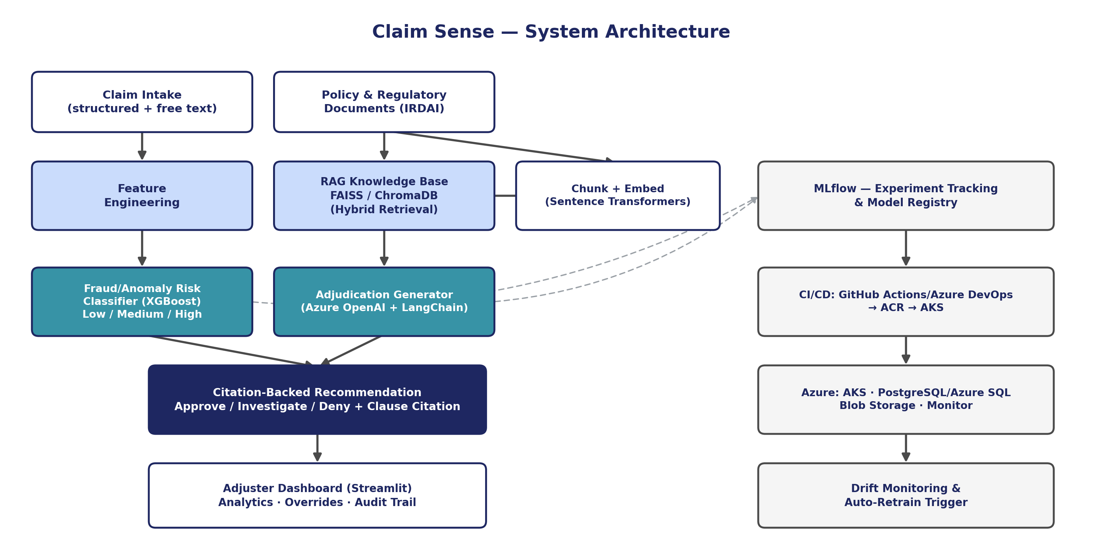
Project 1 | Claim Sense: RAG Claims Adjudication
Architecture Diagram

Slide 9
Project 1 | Claim Sense: RAG Claims Adjudication
Additional Information
IRDAI mandates claim settlement within specific turnaround windows under its current master circulars; Claim Sense's SLA-tracking view can flag claims at risk of breaching these regulatory timelines.
The system's audit_log and model_registry_meta tables give it explainability-by-design — every adjudication can be traced to the exact model version, feature snapshot, and cited clause used.
Because the synthetic fraud rate (8–15%) is deliberately oversampled relative to real-world sub-1% prevalence, Claim Sense reports both raw and prevalence-corrected precision/recall so business impact isn't overstated.
The RAG knowledge base doubles as a training corpus for new adjusters — the same clause-citation engine can power an internal “policy Q&A” copilot beyond claims adjudication.

Slide 10
Project 1 | Claim Sense: RAG Claims Adjudication
Technology Stack
Category | Technology
Programming | Python
RAG framework | LangChain
Embeddings | Sentence Transformers
Vector database | FAISS / ChromaDB
LLM integration | Azure OpenAI
ML classification | Scikit-learn, XGBoost
Experiment tracking | MLflow
Data processing | Pandas, NumPy, Apache Spark
Backend API | FastAPI
Frontend | Streamlit
Database | PostgreSQL / Azure SQL
Deployment | Docker → Azure Container Registry → Azure Kubernetes Service
Monitoring | Azure Monitor
Storage | Azure Blob Storage

Slide 11
Project 1 | Claim Sense: RAG Claims Adjudication
Modules to Cover
Module | Key Tasks
1. Setup & Data Foundations | Provision Azure resources; build synthetic policy + claims generator; ingest real IRDAI circulars
2. RAG Knowledge Base | Chunk/embed policies + circulars; build hybrid (dense+keyword) retrieval; citation resolution
3. Fraud/Risk ML Model | Feature engineering; train LogReg/RF/GBM/XGBoost; MLflow tracking; register best model
4. Adjudication Generation | Prompt design for explainable recommendation + clause citation; hallucination guardrails
5. Dashboard & API | FastAPI endpoints; Streamlit adjuster dashboard; analytics views
6. MLOps & Deployment | Dockerize; CI/CD pipeline; AKS deployment; drift monitoring + auto-retrain trigger
7. Validation & Handover | End-to-end testing on synthetic claims; documentation; demo

Slide 12
Project 1 | Claim Sense: RAG Claims Adjudication
Module 1: Setup & Data Foundations
Provision the Azure resource group, Azure OpenAI, ACR, AKS, PostgreSQL Flexible Server and Blob Storage
Build the synthetic policy-document generator (200–500 documents across motor, health, fire, marine, property)
Build the synthetic claims generator (10,000–50,000 records) with calibrated distributions
Ingest real, current IRDAI master circulars and annual-report statistics as-is into the knowledge base

Slide 13
Project 1 | Claim Sense: RAG Claims Adjudication
Module 2: RAG Knowledge Base
Chunk policy clauses and regulatory circulars; embed with Sentence Transformers
Stand up FAISS/ChromaDB vector store keyed to clause_id for precise citation resolution
Implement hybrid retrieval combining dense similarity search with keyword (BM25-style) search
Validate retrieval quality against a held-out set of known clause references

Slide 14
Project 1 | Claim Sense: RAG Claims Adjudication
Module 3: Fraud/Risk ML Model
Engineer features: claim amount vs. sum insured, tenure, days-since-policy-start, prior claim count
Train and compare Logistic Regression, Random Forest, Gradient Boosting and XGBoost
Calibrate against reference datasets (Kaggle auto-claims, IEEE-CIS) for realistic class imbalance
Track every experiment in MLflow and register the best model to the model registry

Slide 15
Project 1 | Claim Sense: RAG Claims Adjudication
Module 4: Adjudication Generation
Design prompts that force the LLM to cite only retrieved clause IDs (no free-invented citations)
Combine the fraud/risk score with retrieved clauses to produce Approve / Investigate / Deny output
Add guardrails and an LLM-as-judge consistency check against hallucinated clause references
Log every generated recommendation with its reasoning text and cited_clause_ids array

Slide 16
Project 1 | Claim Sense: RAG Claims Adjudication
Module 5: Dashboard & API
Build FastAPI endpoints for claim intake, scoring, retrieval and adjudication
Build the Streamlit adjuster dashboard: claim queue, recommendation view, override capture
Add analytics views: claim-trend charts, fraud-risk distribution, clause-citation frequency
Wire the dashboard to PostgreSQL/Azure SQL for live claim and decision data

Slide 17
Project 1 | Claim Sense: RAG Claims Adjudication
Module 6: MLOps & Deployment
Containerize the API, worker and dashboard services with Docker
Set up CI/CD via GitHub Actions/Azure DevOps: build → test → push to ACR → deploy to AKS
Configure Azure Monitor/Application Insights for logs, traces and model-serving latency
Implement drift monitoring on incoming claim features with an auto-retrain trigger

Slide 18
Project 1 | Claim Sense: RAG Claims Adjudication
Module 7: Validation & Handover
Run end-to-end testing on a held-out batch of synthetic claims across all product lines
Validate adjudication accuracy, clause-citation precision, and fraud-classifier metrics (AUC, F1)
Prepare documentation: data dictionary, API reference, model card, deployment runbook
Deliver a live demo of the adjuster dashboard end-to-end

Slide 19
Project 2 | Site Guard AI: Multi-Agent Safety System
Introduction
Large EPC construction sites generate thousands of free-text safety observations, near-misses, NCRs and DPRs across contractors; engineers manually cross-reference IS codes, BOCW norms and past logs, taking hours per incident with inconsistent root-cause tracking.
Site Guard AI is a LangGraph multi-agent system — Intake → Retrieval → Root-Cause → Corrective Action → Escalation — that turns a free-text report into a structured incident, a code-grounded root-cause analysis, a CAPA with an owner and due date, and an automatic escalation for critical/repeat violations.
Outcome: root-cause turnaround drops from hours to minutes, repeat violations are caught automatically, and every recommendation is traceable to a real IS-code/BOCW clause.
As a product, Site Guard AI ships as an incident-queue dashboard with an agent-reasoning trace and CAPA tracker — deployable fully local (Docker Compose + Ollama) for cost-free pilots, or on Azure (ACI/AKS) for scaled EPC deployments.

Slide 20
Project 2 | Site Guard AI: Multi-Agent Safety System
Objective
Structure free-text safety/quality reports into a consistent schema (site, contractor, severity, trade) via the Intake Agent
Build a RAG knowledge base over IS codes, the BOCW Act/Rules and site SOPs for the Retrieval Agent
Perform chain-of-thought root-cause analysis against a construction-specific FMEA/5-Why library
Draft corrective/preventive actions (CAPA) with a responsible party and due date
Auto-escalate Critical-severity or repeat-violation incidents to the safety officer
Orchestrate all five agents as a LangGraph state machine with human-in-the-loop review points
Support both a fully local (Ollama + Llama 3.1 8B) and a cloud (Azure OpenAI) deployment path

Slide 21
Project 2 | Site Guard AI: Multi-Agent Safety System
Scope
Area | In-Scope | Out-of-Scope
Data | Synthetic DPR/NCR/observation generator (5,000–15,000 records) calibrated to OSHA SIR & DGFASLI statistics | Real, site-identifying incident records (contractual/PII-sensitive)
Knowledge base | RAG over real IS codes, BOCW Act/Rules, OSHA 29 CFR 1926, and synthetic SOPs | Non-construction regulatory domains
Agents | Intake, Retrieval, Root-Cause, Corrective Action and Escalation agents in LangGraph | Autonomous CAPA closure without human sign-off
Root-cause | FMEA/5-Why chain grounded in a curated failure-mode library | Physical/forensic accident reconstruction (e.g., structural failure simulation)
Interface | Incident queue, agent-reasoning-trace view, CAPA tracker (Streamlit/React) | Worker-facing mobile reporting app (future phase)
Deployment | Docker Compose (fully local) or Azure ACI/AKS (cloud) | Multi-cloud or on-premise bare-metal Kubernetes

Slide 22
Project 2 | Site Guard AI: Multi-Agent Safety System
Literature Review
No | Paper / Source (Author, Year) | Focus | Key Insight Used in Site Guard AI
1 | LangChain AI, 2024/2026 | LangGraph: building structured multi-agent LLM applications | Core orchestration framework adopted for the Intake→Escalation agent graph
2 | Baek, Park & Jung, 2025 (Automation in Construction) | RAG-enhanced automated safety-risk-management guidance | Precedent for grounding safety recommendations in retrieved code text
3 | Bernardi, Cimitile & Pecori, 2024 (IJCNN) | Automatic job-safety report generation using RAG-based LLMs | Validates RAG for generating structured safety documentation
4 | ASCE J. Mgmt. in Engg., 2025/26 | LLM-based multi-agent system for construction job-safety analysis | Closest published precedent for a multi-agent safety-analysis pipeline
5 | Chen et al., 2025 (Adv. Eng. Informatics) | Meet2Mitigate: LLM framework for real-time issue ID from site meetings | Informs the Intake Agent's free-text-to-structured-issue extraction

Slide 23
Project 2 | Site Guard AI: Multi-Agent Safety System
Literature Review (contd.)
No | Paper / Source (Author, Year) | Focus | Key Insight Used in Site Guard AI
6 | Ahmadi, Muley & Wang, 2025 (J. Intelligent Constr.) | LLMs (GPT-4, Gemini, Llama 3.1) for construction accident-report analysis | Llama 3.1 8B chosen partly on this paper's reported accuracy
7 | Wang et al., 2026 (ECAM) | Parameter-efficient fine-tuned LLMs + ensembles for accident-report classification | Considered for fine-tuning the local Llama 3.1 8B Intake Agent
8 | Zhang, 2022 (Int. J. Constr. Mgmt.) | Hybrid deep neural network + Word2Vec for accident-cause classification | Baseline for structured cause-taxonomy design
9 | ScienceDirect, 2020 | Deep learning + network analysis for classifying accident narratives | Informs the FMEA/5-Why failure-mode taxonomy structure
10 | ScienceDirect (graph-based DL) | Graph-based deep learning for accident injury-type/body-part extraction | Considered for future enrichment of the incident schema

Slide 24
Project 2 | Site Guard AI: Multi-Agent Safety System
Summary of Literature
Published work confirms LLM-based agents reliably extract structured fields (trade, severity, cause) from free-text safety narratives, and that grounding generation in retrieved code/standard text (RAG) is now the standard approach for auditable safety recommendations.
Multi-agent orchestration (LangGraph and similar frameworks) is an active 2024–2026 research area but published multi-agent systems specific to construction safety root-cause-to-CAPA workflows remain scarce — most work stops at single-agent classification or report generation.
This gap is exactly where Site Guard AI contributes chaining Intake → Retrieval → Root-Cause → Corrective Action → Escalation into one auditable LangGraph pipeline with a reasoning trace.

Slide 25
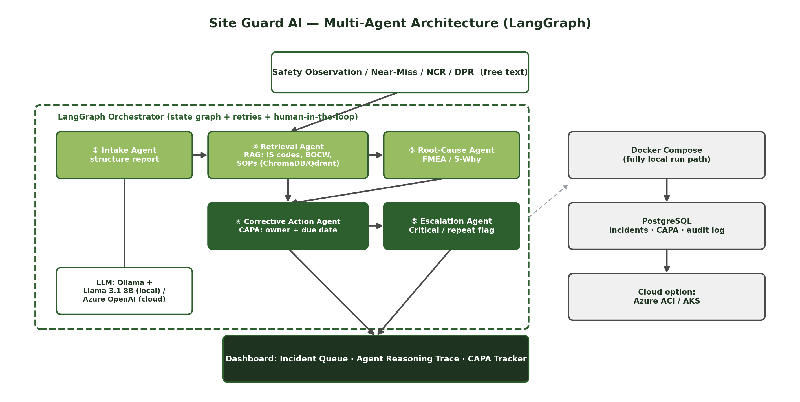
Project 2 | Site Guard AI: Multi-Agent Safety System
Architecture Diagram

Slide 26
Project 2 | Site Guard AI: Multi-Agent Safety System
Additional Information
BOCW Central Rules Chapter XIII and BIS codes such as IS 3696 (scaffolds) give Site Guard AI real, citable clause numbers — the Root-Cause Agent is designed to never fabricate a clause number, only cite verified ones.
The agent_reasoning_trace table means every escalation or CAPA can be replayed step-by-step for a safety audit — a feature most commercial EHS software doesn't expose.
Because Ollama + Llama 3.1 8B runs fully offline, Site Guard AI can be piloted on a site with no reliable internet connectivity, then switched to Azure OpenAI once the contractor scales to multiple sites.
Repeat-violation detection (same contractor/trade/site recurring) turns Site Guard AI from a passive logger into a proactive enforcement tool — a capability regulators like DGFASLI have flagged as missing in most site EHS systems.

Slide 27
Project 2 | Site Guard AI: Multi-Agent Safety System
Technology Stack
Layer | Technology
Agent framework | LangGraph
LLM | Ollama + Llama 3.1 8B (local) / Azure OpenAI (cloud option)
Knowledge base | ChromaDB / Qdrant + Sentence Transformers
Backend | FastAPI + Pydantic
Frontend | Streamlit or React dashboard (incident queue, agent reasoning trace, CAPA tracker)
Database | PostgreSQL (incidents, CAPA, audit trail)
Deployment | Docker Compose → Azure Container Instances / AKS, or fully local
Synthetic data | Generate synthetic DPRs, safety observations, NCRs (5,000–15,000 records) simulating multiple trades/sites

Slide 28
Project 2 | Site Guard AI: Multi-Agent Safety System
Modules to Cover
Module | Key Tasks
1. Setup & Data Foundations | Provision Docker Compose/Azure; build synthetic DPR/NCR generator; ingest real IS codes + BOCW Act/Rules
2. Knowledge Base (Retrieval Agent) | Chunk/embed IS codes, BOCW clauses, SOPs, past-incident corpus; hybrid retrieval
3. Intake Agent | Free-text → structured schema via prompt design + validation
4. Root-Cause Agent | Curate FMEA/5-Why library; chain-of-thought prompt grounded in retrieved clauses
5. Corrective Action & Escalation Agents | CAPA drafting with owner/due-date; critical/repeat-violation escalation rules
6. LangGraph Orchestration | Wire agents into a graph with state passing, retries, human-in-the-loop review
7. Dashboard & API | FastAPI endpoints; incident queue, reasoning-trace, CAPA tracker UI
8. Deployment & Validation | Docker Compose local path; optional ACI/AKS cloud path; end-to-end testing

Slide 29
Project 2 | Site Guard AI: Multi-Agent Safety System
Module 1: Setup & Data Foundations
Provision Docker Compose services (or Azure ACI) for the API, database and agent workers
Build the synthetic DPR/NCR/observation generator (5,000–15,000 records) across multiple trades/sites
Calibrate synthetic data against OSHA Severe Injury Report and DGFASLI safety statistics
Ingest real, current IS codes and BOCW Act/Rules text into the knowledge base as-is

Slide 30
Project 2 | Site Guard AI: Multi-Agent Safety System
Module 2: Knowledge Base (Retrieval Agent)
Chunk and embed IS codes, BOCW clauses, site SOPs and the past-incident corpus with Sentence Transformers
Stand up ChromaDB/Qdrant vector store keyed to clause_id for precise citation
Implement hybrid retrieval combining semantic similarity with keyword search
Validate retrieval against a held-out set of known code references

Slide 31
Project 2 | Site Guard AI: Multi-Agent Safety System
Module 3: Intake Agent
Design prompts that convert free-text observations/NCRs/DPRs into a structured schema
Extract site, contractor, severity and trade fields with validation rules
Handle ambiguous or incomplete reports with a clarification/fallback path
Benchmark extraction accuracy against a manually labelled synthetic sample

Slide 32
Project 2 | Site Guard AI: Multi-Agent Safety System
Module 4: Root-Cause Agent
Curate a construction-specific FMEA/5-Why failure-mode library
Design chain-of-thought prompts that ground root-cause reasoning in retrieved clauses
Ensure every root-cause explanation cites a verified IS-code/BOCW reference, never a fabricated one
Validate root-cause quality against past-incident precedents in the corpus

Slide 33
Project 2 | Site Guard AI: Multi-Agent Safety System
Module 5: Corrective Action & Escalation Agents
Draft CAPA (corrective/preventive action) text with a responsible party and due date
Design escalation rules for Critical-severity incidents and repeat-violation patterns
Route escalations to the safety officer with full context and reasoning trace
Log every CAPA and escalation to the audit trail for compliance reporting

Slide 34
Project 2 | Site Guard AI: Multi-Agent Safety System
Module 6: LangGraph Orchestration
Wire the five agents into a LangGraph state graph with typed state passing
Add retry logic and human-in-the-loop checkpoints before CAPA/escalation commit
Implement graph-level logging so every run can be replayed step-by-step
Test end-to-end graph execution on synthetic incident batches

Slide 35
Project 2 | Site Guard AI: Multi-Agent Safety System
Module 7: Dashboard & API
Build FastAPI + Pydantic endpoints for incident intake, retrieval and agent orchestration
Build the incident-queue dashboard with an agent-reasoning-trace view (Streamlit/React)
Build the CAPA tracker with owner, due-date and status views
Wire the dashboard to PostgreSQL for incidents, CAPA and the audit trail

Slide 36
Project 2 | Site Guard AI: Multi-Agent Safety System
Module 8: Deployment & Validation
Package all services with Docker Compose for the fully local run path
Configure the optional Azure ACI/AKS cloud deployment path
Run end-to-end testing across synthetic incidents spanning multiple trades/sites
Prepare documentation: schema reference, agent-prompt library, deployment runbook, demo

